Slide 1
Cultivation of viruses:
Ex vivo/ In vitro

Slide 2

Cell culture:
Cell culture is the process by which prokaryotic, eukaryotic or plant cells are grown under controlled conditions.
Cell culture was first successfully undertaken by Ross Harrison in 1907

Slide 3
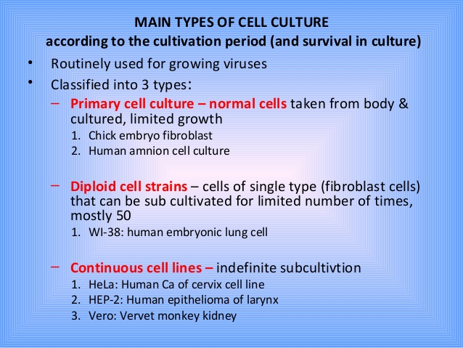

Slide 4
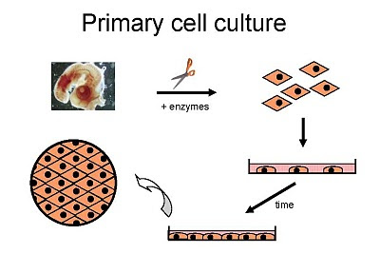
Cells when surgically or enzymatically (e.g. Trypsin) removed from an organism and placed in suitable culture environment will attach and grow are called as primary culture.

Slide 5
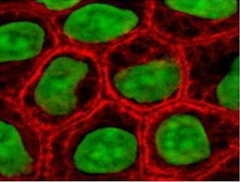
Primary cells have a finite life span
Sub culturing of primary cells leads to the generation of cell lines
Cell lines have limited life span, they passage several times before they become senescent
Lineage of cells originating from the primary culture is called a cell strain
In the primary culture the cells retain some of the characteristics of the tissue from which they were derived and are mainly of two types:
thin & elongated (fibroblast like)
polygonal, tend to form sheets (epithelium like)

Slide 6
Diploid cell lines
These are those in which at least 75% of the cells have the same Karyotype as normal cells of the species from which the cells were originally cultured. 'These lines do not have the property of indefinite serial passage but tend to die out by the fifteenth passage. In the past diploid cells in serial passage were frequently referred to as cells strains, but the term cell strain is now applied more specifically to cells derived from either primary culture or cell line by the selection of cloning of cells having specific properties of markers.

Slide 7
Major development’s in cell culture technology
First development was the use of antibiotics which inhibits the growth of contaminants.
Second was the use of trypsin to remove adherent cells to subculture further from the culture vessel
Third was the use of chemically defined culture medium.

Slide 8
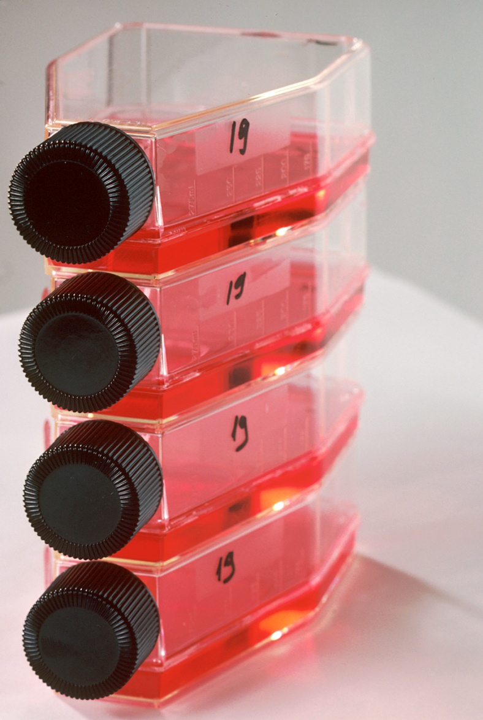
Secondary cell culture
Cells for secondary cell culture are obtained from an already established primary culture. Therefore, secondary culture is new culture originated from the primary culture.

Slide 9
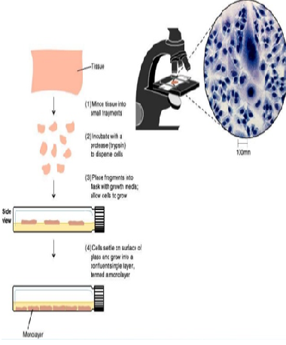
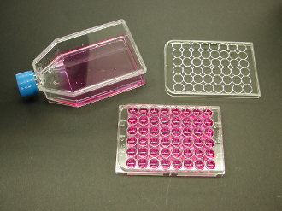
Monolayer cell culture
When grown under the proper condition the cells in culture multiply and cover the bottom of the glass container with a thin but continuous layer, which is often one cell thick, such layers are called monolayer.

Slide 10
Why sub culturing..?
Once the available substrate surface is covered by cells (a confluent culture) growth slows & ceases.
Cells to be kept in healthy & in growing state have to be sub-cultured or passaged
It’s the passage of cells when they reach to 80-90% confluency in flask/dishes/plates
Enzyme such as trypsin, dipase, collagenase in combination with EDTA breaks the cellular glue that attached the cells to the surface

Slide 11
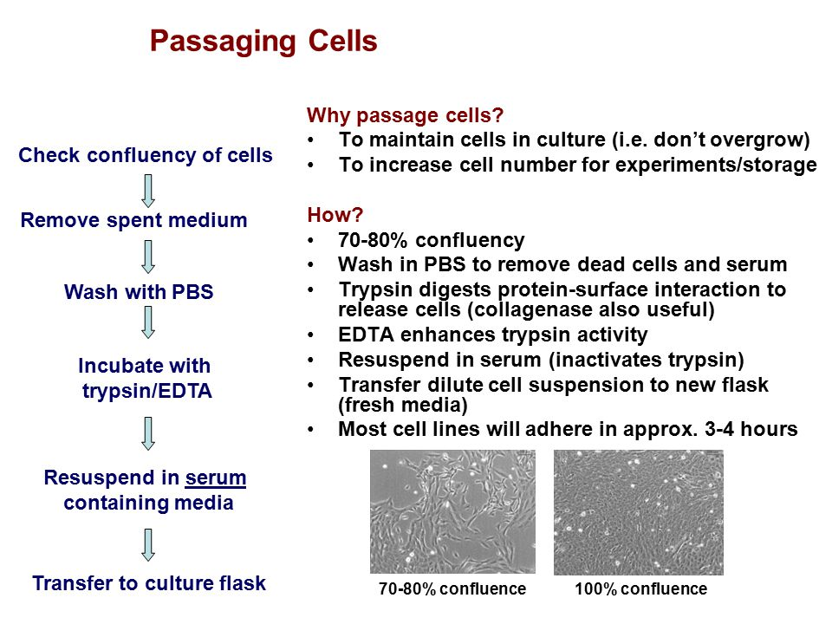
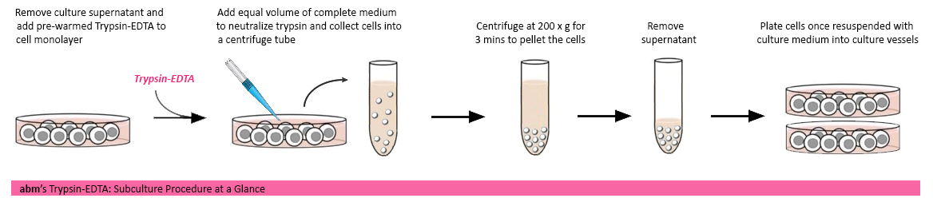

Slide 12
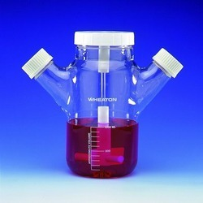
Suspension cells
Suspension culture is a type of culture in which single cells or small aggregates of cells multiply while suspended in agitated liquid medium. It is also referred to as cell culture or cell suspension culture.
Easier to passage as no need to detach them
As the suspension cells reach to confluency
Asceptically remove 1/3rd of medium
Replaced with the same amount of pre-warmed medium

Slide 13
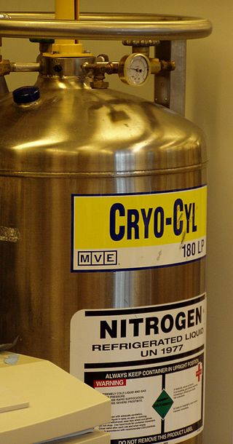
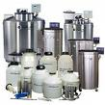
Cryopreservation
Cryopreservation or cryoconservation is a process where cells, whole tissues, or any other substances susceptible to damage caused by chemical reactivity or time are preserved by cooling to sub-zero temperatures. At low enough temperatures, any enzymatic or chemical activity which might cause damage to the material in question is effectively stopped.

Slide 14
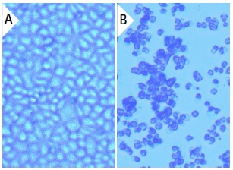
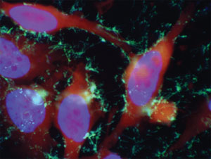
Cell viability
Cell viability is determined by staining the cells with trypan blue
As trypan blue dye is permeable to non-viable cells or death cells whereas it is impermeable to this dye
Stain the cells with trypan dye and load to haemocytometer and calculate % of viable cells
- % of viable cells= No. of unstained cells x 100
total no. of cells

Slide 15
Common cell lines
Human cell lines
-MCF-7 breast cancer
HL 60 Leukemia
HEK-293 Human embryonic kidney
HeLa Henrietta lacks
Primary cell lines
Vero African green monkey kidney epithelial cells
Cos-7 African green monkey kidney cells
And others such as CHO from hamster, sf9 & sf21 from insect cells

Slide 16
Why is cell culture used for?
Areas where cell culture technology is currently playing a major role.
Model systems for
Studying basic cell biology, interactions between disease causing agents and cells, effects of drugs on cells, process and triggering of aging & nutritional studies.
Toxicity testing
Cancer research
Virology
Genetic Engineering
Gene therapy

Slide 17
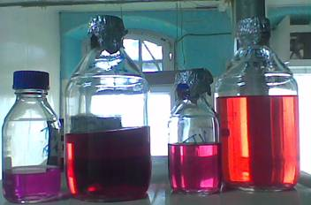
Culture media
Choice of media depends on the type of cell being cultured
Commonly used Medium are GMEM, EMEM,DMEM etc.
Media is supplemented with antibiotics viz. penicillin, streptomycin etc.
Prepared media is filtered and incubated at 4 C

Slide 18
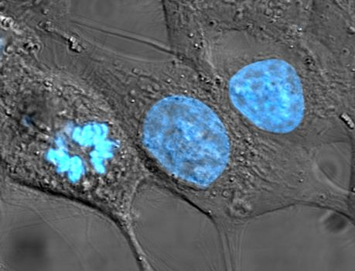
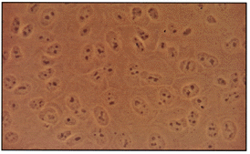
Contaminant’s of cell culture
Cell culture contaminants of two types
Chemical-difficult to detect caused by endotoxins, plasticizers, metal ions or traces of disinfectants that are invisible
Biological-cause visible effects on the culture they are mycoplasma, yeast, bacteria or fungus or also from cross-contamination of cells from other cell lines

Slide 19
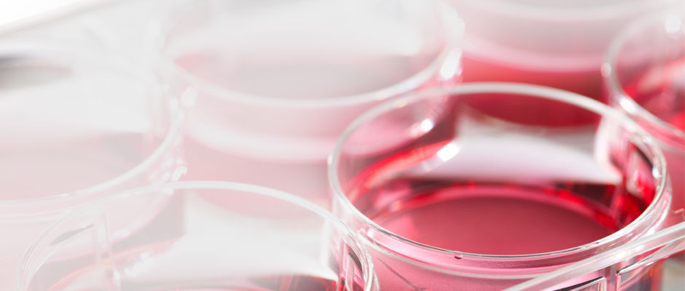
Thank you

